Slide 1
IoT- Based Virtual Doctor Robot
Sri Abirami N
Biomedical Engineering
SNS College of Technology

Slide 2
Problem Statement:
In times of infectious disease outbreaks or in remote healthcare settings, patient-doctor contact can pose a risk. Traditional monitoring also requires manual effort, which may not be efficient or scalable.

Slide 3
Objective:
To design a virtual doctor robot system using IoT that can monitor basic health parameters (like temperature), interact with patients, and transmit data to healthcare professionals in real time, reducing physical contact and improving efficiency.

Slide 4
Components Used:
Arduino UNO – Controls robot functions
Temperature Sensor (DHT11) – Measures patient’s body temperature
Wi-Fi Module (ESP8266) – Sends data to cloud or remote screen
LCD Display – Shows real-time readings
Motor Driver + Wheels – Moves robot toward patients
Buzzer/Speaker – Enables voice alert/interaction

Slide 5
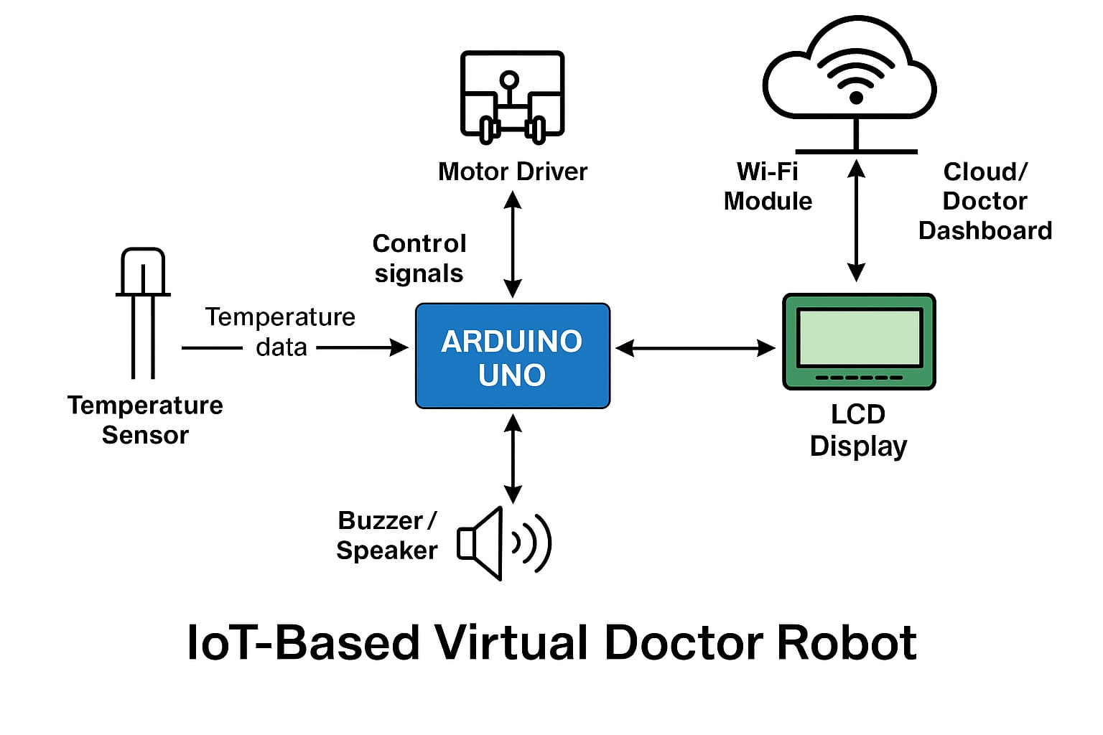
Working Block Diagram:

Slide 6
Advantages:
Enables contactless basic health checkups
Real-time monitoring from remote locations
Can be expanded to include more sensors (pulse, SPO2)
Useful during pandemics or in quarantine zones

Slide 7
Conclusion & Future Scope:
This robot proves how IoT and robotics can be applied in healthcare to assist doctors, reduce risk, and improve efficiency.
Future scope:
Adding AI-based voice interaction
Integrating telemedicine video interface
Connecting to AWS IoT or Thingspeak for cloud storage

Slide 8
THANK YOU.

